Slide 1
Digital Signal Processing
Dr. Michael Nasief
Lec 5

Slide 2
Ex 1
The first nonzero value of a finite-length sequence x(n) occurs at index n = -6 and has a value x(-6) = 3, and the last nonzero value occurs at index n = 24 and has a value x(24) = -4. What is the index of the first nonzero value in the convolution

Slide 3
Ex 2
The convolution of two finite-length sequences will be finite in length. is it true that the convolution of a finite-length sequence with an infinite-length sequence will be infinite in length?
It is not necessarily true It may be either

Slide 4
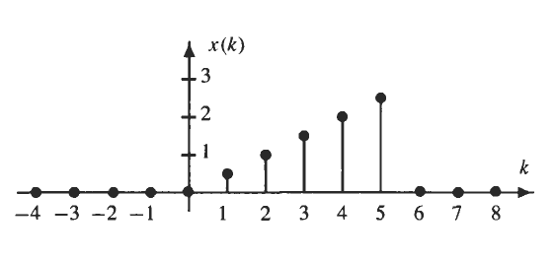
EX 3
Convolve

Slide 5
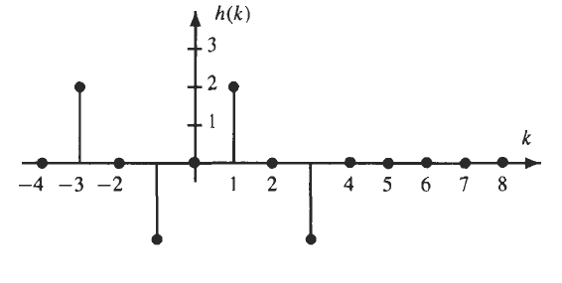

Slide 6
Because h(n) is equal to zero outside the interval [-3, 3], and x(n) is zero outside the interval [l, 5], the convolution y(n) = x(n) * h(n) is zero outside the interval [-2, 8].

Slide 8
Another Method

Slide 10
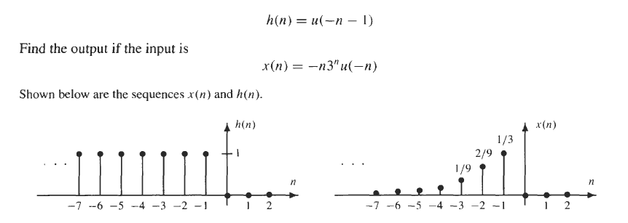
Ex 4

Slide 12
Chapter [2]
Fourier Analysis

Slide 13
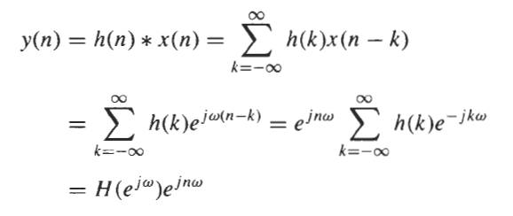
FREQUENCY RESPONSE
Signals of the form

Slide 14
Complex Value

Slide 15
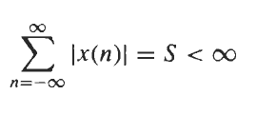
THE DISCRETE-TIME FOURIER TRANSFORM
The discrete-time Fourier transform (DTFT) of a sequence, x(n), is defined as
In order for the DTFT of a sequence to exist, the summation in Eq. (2.3) must converge. This, in turn, requires that x(n) be absolutely summable:

Slide 16
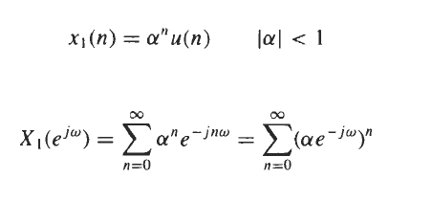
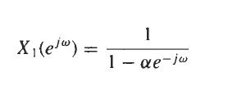
EXAMPLE

Slide 17
IDTFT

Slide 18
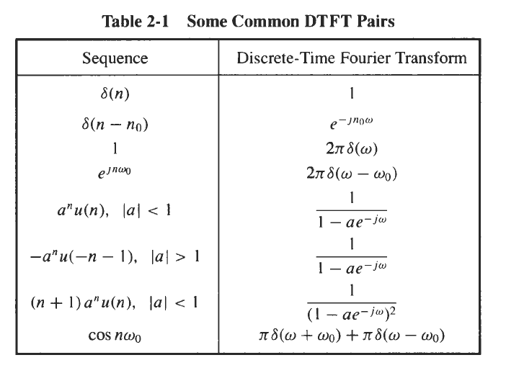

Slide 19
